Slide 1

Tough Tools, Perfect Solution
TORCSTAR BOLTING TOOLS
ISO 9001:2008 Certified

Slide 2
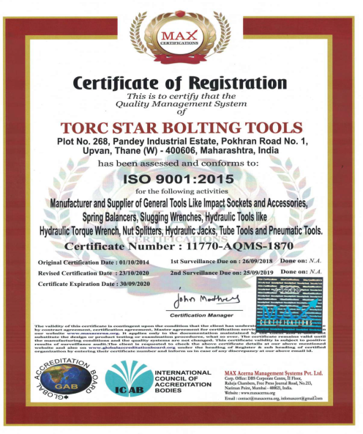
CERTIFICATION

Slide 3
COMPANY PROFILE
                INTRODUCTION
We are delighted to introduce TORCSTAR, India’s leading manufacturer of Bolting Tools, Tube Tools and General tools having pedigree of 25 years of production in India and supplying to 35 countries across globe including India. Our business module depends on dealer’s network with robust technical sales channels to cater customer requirements as per application based.
We are an ISO 9001 certified manufacturing organization based at Mumbai, in India with over 60% of our production for worldwide exports.
OUR CLIENTELE
All our overseas buyers have reposed their faith in us through repeat orders. This is mainly due to our Consistency in Quality, Pricing and Timely Supplies.
We supply Torcstar Products to countries like Singapore, Malaysia, Indonesia, Qatar, Oman, Saudi,
  UAE, Kuwait. We also have few customers in regions like USA, Europe and UK.
We are pleased to inform you that our Products are successfully used by our regular clients in India and abroad like.

Slide 4
CLIENTS
SEGMENTS WE CATER (EXPORT / DOMESTIC)
GAS AND PETROLEUM : Shell, Exxon, GE, BP, IOCL, ONGC, ARAMCO. ONGC, GAIL, HPCL, BPCL, Reliance.
FERTILIZER SECTOR : Qatar Fertilizers, Oman Fertilizers, National fertilizers,
KRIBHCO, CHAMBAL-India.
AUTOMOBILE SECTOR : Toyota, Hyundai, Honda, Caterpillar, Ford, TATA,
Mahindra, JCB, BAJAJ.
CEMENT SECTOR : Oman Cement, ULTRATECH, Ambuja Cement, ACC.
STEEL & AL. SECTOR : Jindal Steel, Essar, Oman Aluminum, Qatalum, SAIL.
HEAVY ENGINEERING : BHEL, BEML, L&T, ELECON

Slide 5
Products We Can Offer
PRODUCT PORTFOLIO
Products that Torcstar can add to Portfolio in General Tooling are as below :
Impact Socket
Hex Bit Sockets
Slugging Wrench
Square Drive Adapter
Manual Torque Wrench
Customized Mechanical Parts.
Torque Multipliers
Hex Reducers / Insert Socket
Bolt Tensioner Adapter Kit
A) Nut Rotating Socket
B) Bridge
c) Puller

Slide 6
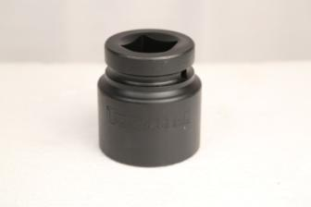
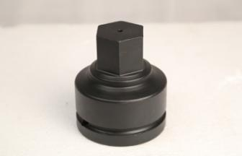
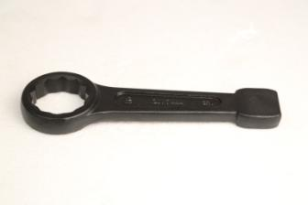
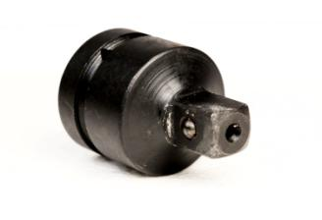
core manufacturing strength
IMPACT SOCKET
HEX BIT SOCKER
SLUGGING WRENCH
SQUARE ADAPTER

Slide 7
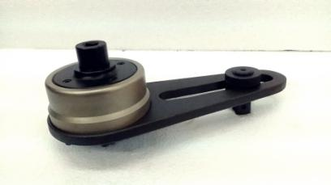
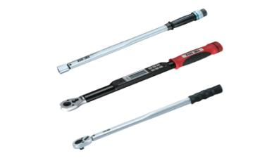
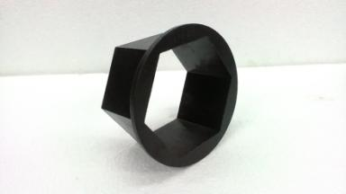
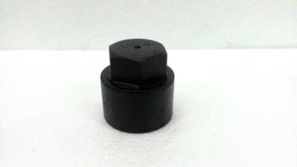
core manufacturing strength
TORQUE MULTIPLIER
MANUAL TORQUE WRENCH
HEX REDUCER
INSERT SOCKET

Slide 8
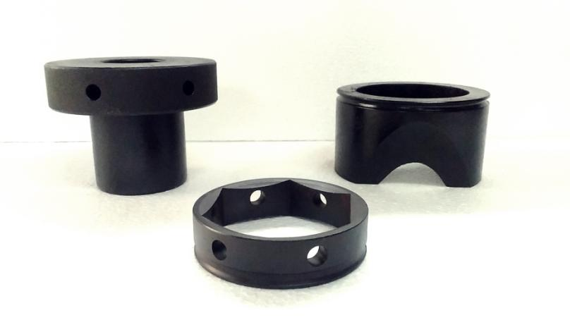
core manufacturing strength
BOLT TENSIONER ADAPTER KIT (BRIDGE , PULLERS, NUT ROTATING SOCKETS)

Slide 9
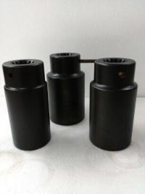
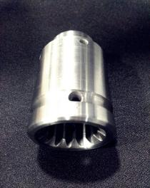
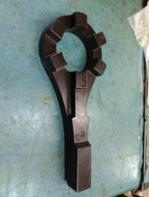
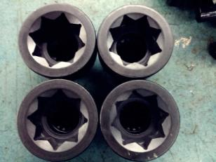
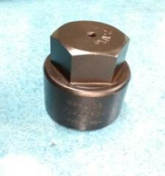
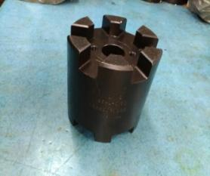
customized products

Slide 10
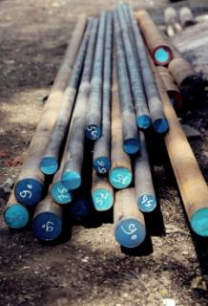
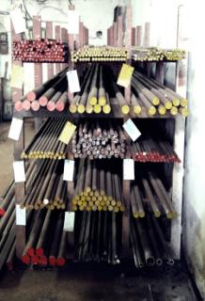
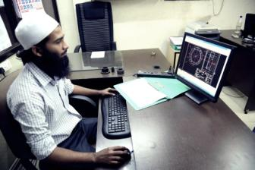
Company setup
RAW MATERIAL
INCOMING
STORAGE
DESIGN & DEVELOPMENT

Slide 11
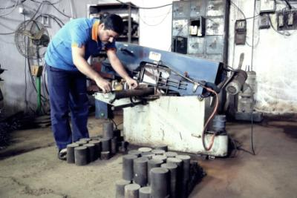
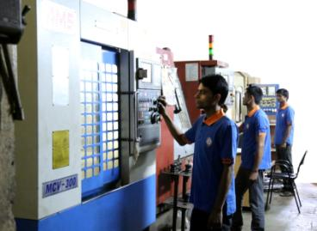
Company setup
CUTTING
OPERATION
CNC OPERATIONS

Slide 12
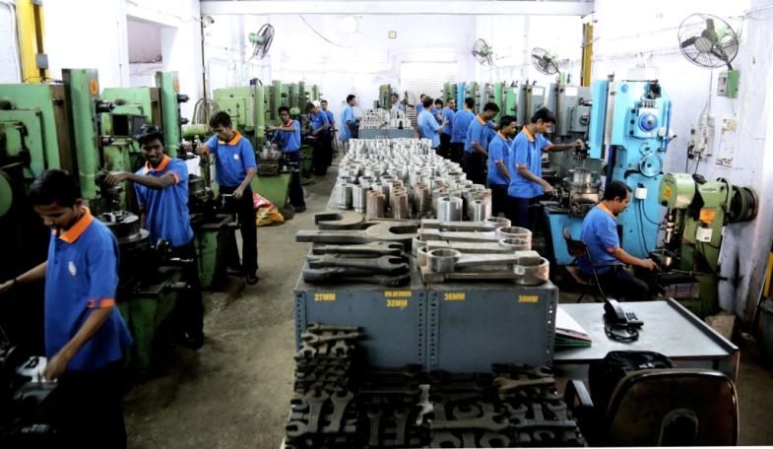
Company setup
MECHANICAL OPERATIONS

Slide 13
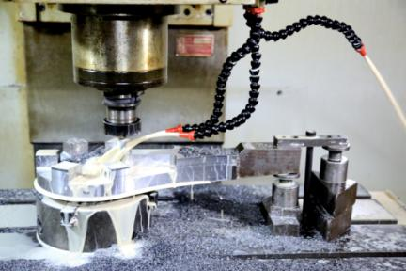
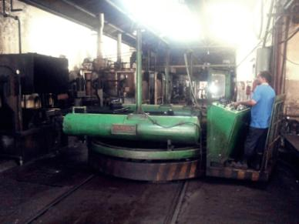
Company setup
MILLING
SETUP
HARDENING & BLACKENING

Slide 14
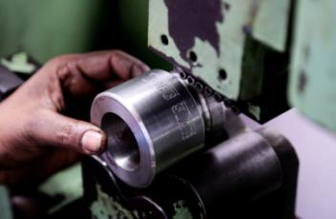
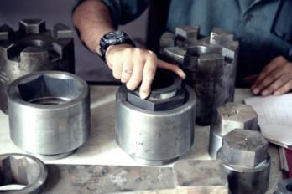
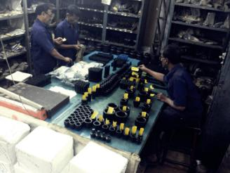
Company setup
BRANDING
QUALITY CONTROL
STORAGE DEPARTEMENT

Slide 15

Website :http://www.torcstar.com/ Manufacturing Setup :http://www.torcstar.com/gallery/
Mr. Bhaskar - 9820120501 Mr. Deepak - 9811313420 (CEO) (Marketing Head)

